Slide 1

Food waste Estimation A Global perspective
2021
Felipe Arenas

Slide 2

Table of contents
Introduction to Global Food Waste Analysis
Data Wrangling Process
Exploratory Data Analysis: Descriptive Statics - Classification of variables
Results Interpretation and Business Questions
Dashboard Analysis
Insights and Recommendations for Stakeholders

Slide 3
introduction
Analysis based on 2021 data from 215 countries
Focus on Household, Food Services, and Retail sectors
China and India are top contributors
Slovenia and Austria have the lowest food waste levels
Household sector leads due to lack of consumer awareness

Slide 4
Data Wrangling process
Power Query
Data Structuring
Data Consistency
Data Cleaning
Data availability

Slide 5
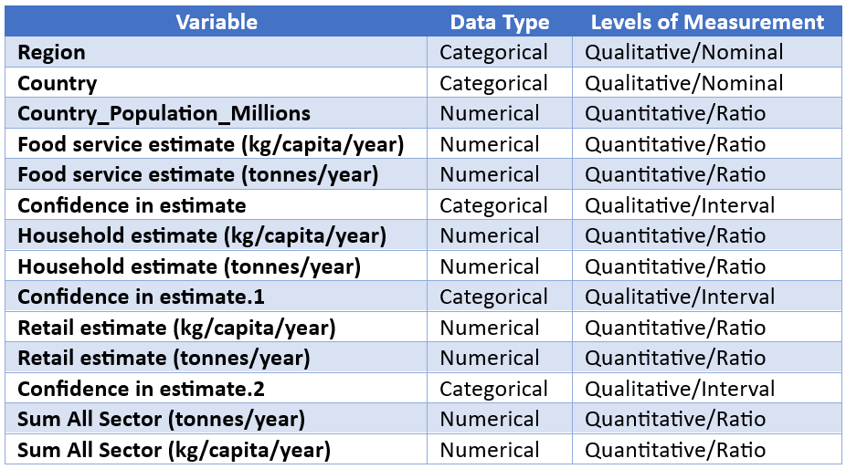
Exploratory Data Analysis Descriptive Statics – classification of variables
126 kg
Average per capita Food Waste
123 kg
Median per capita Food Waste

Slide 6
Results Interpretation and Business Questions
High Questions
Which country wasted the most food in 2021?
Which region wasted the most food per tonnes in 2021?
Which sector generated the most food waste per tonnes in 2021?
How many countries, categorized by sector, have confidence in their data estimates?

Slide 7
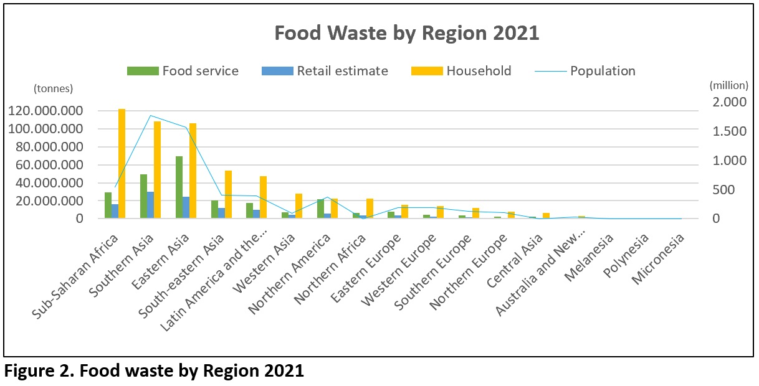
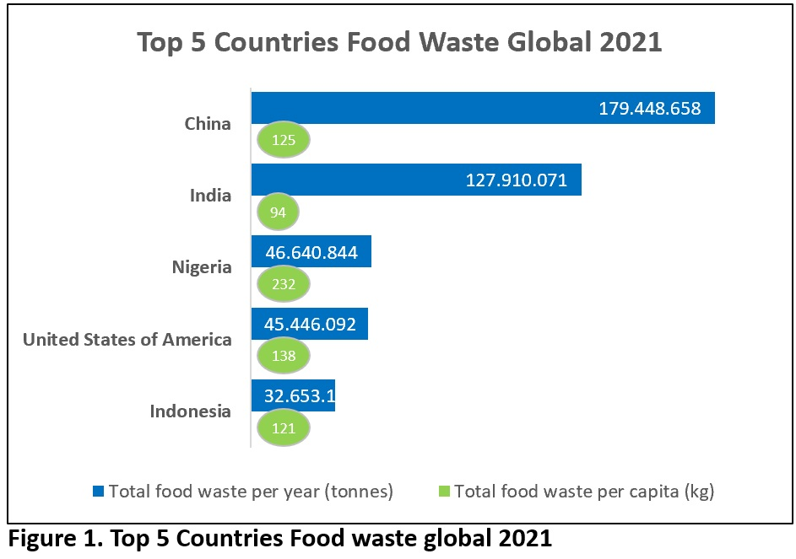
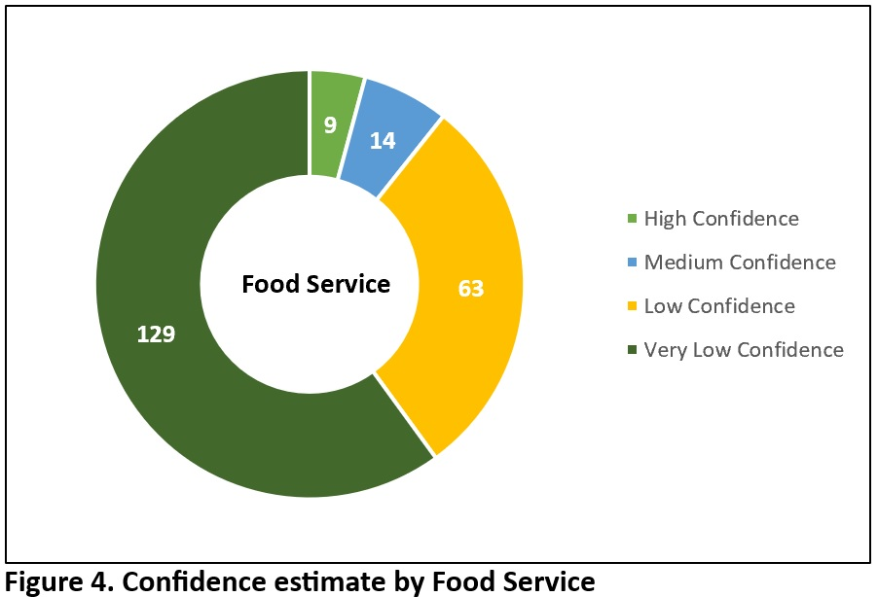
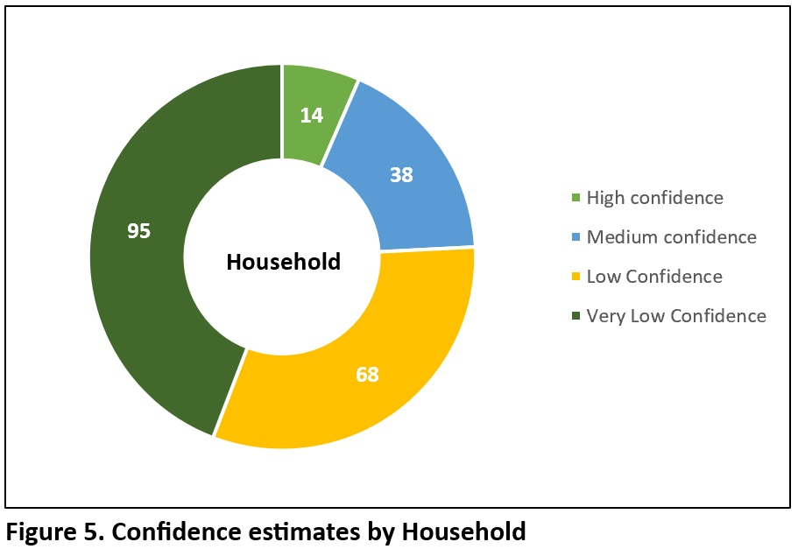
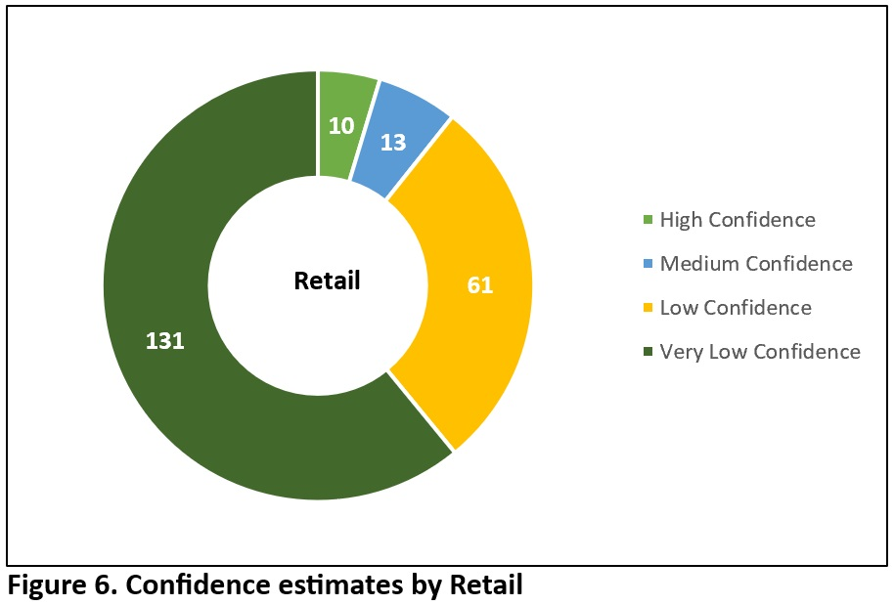
Results Interpretation and Business Questions

Slide 8
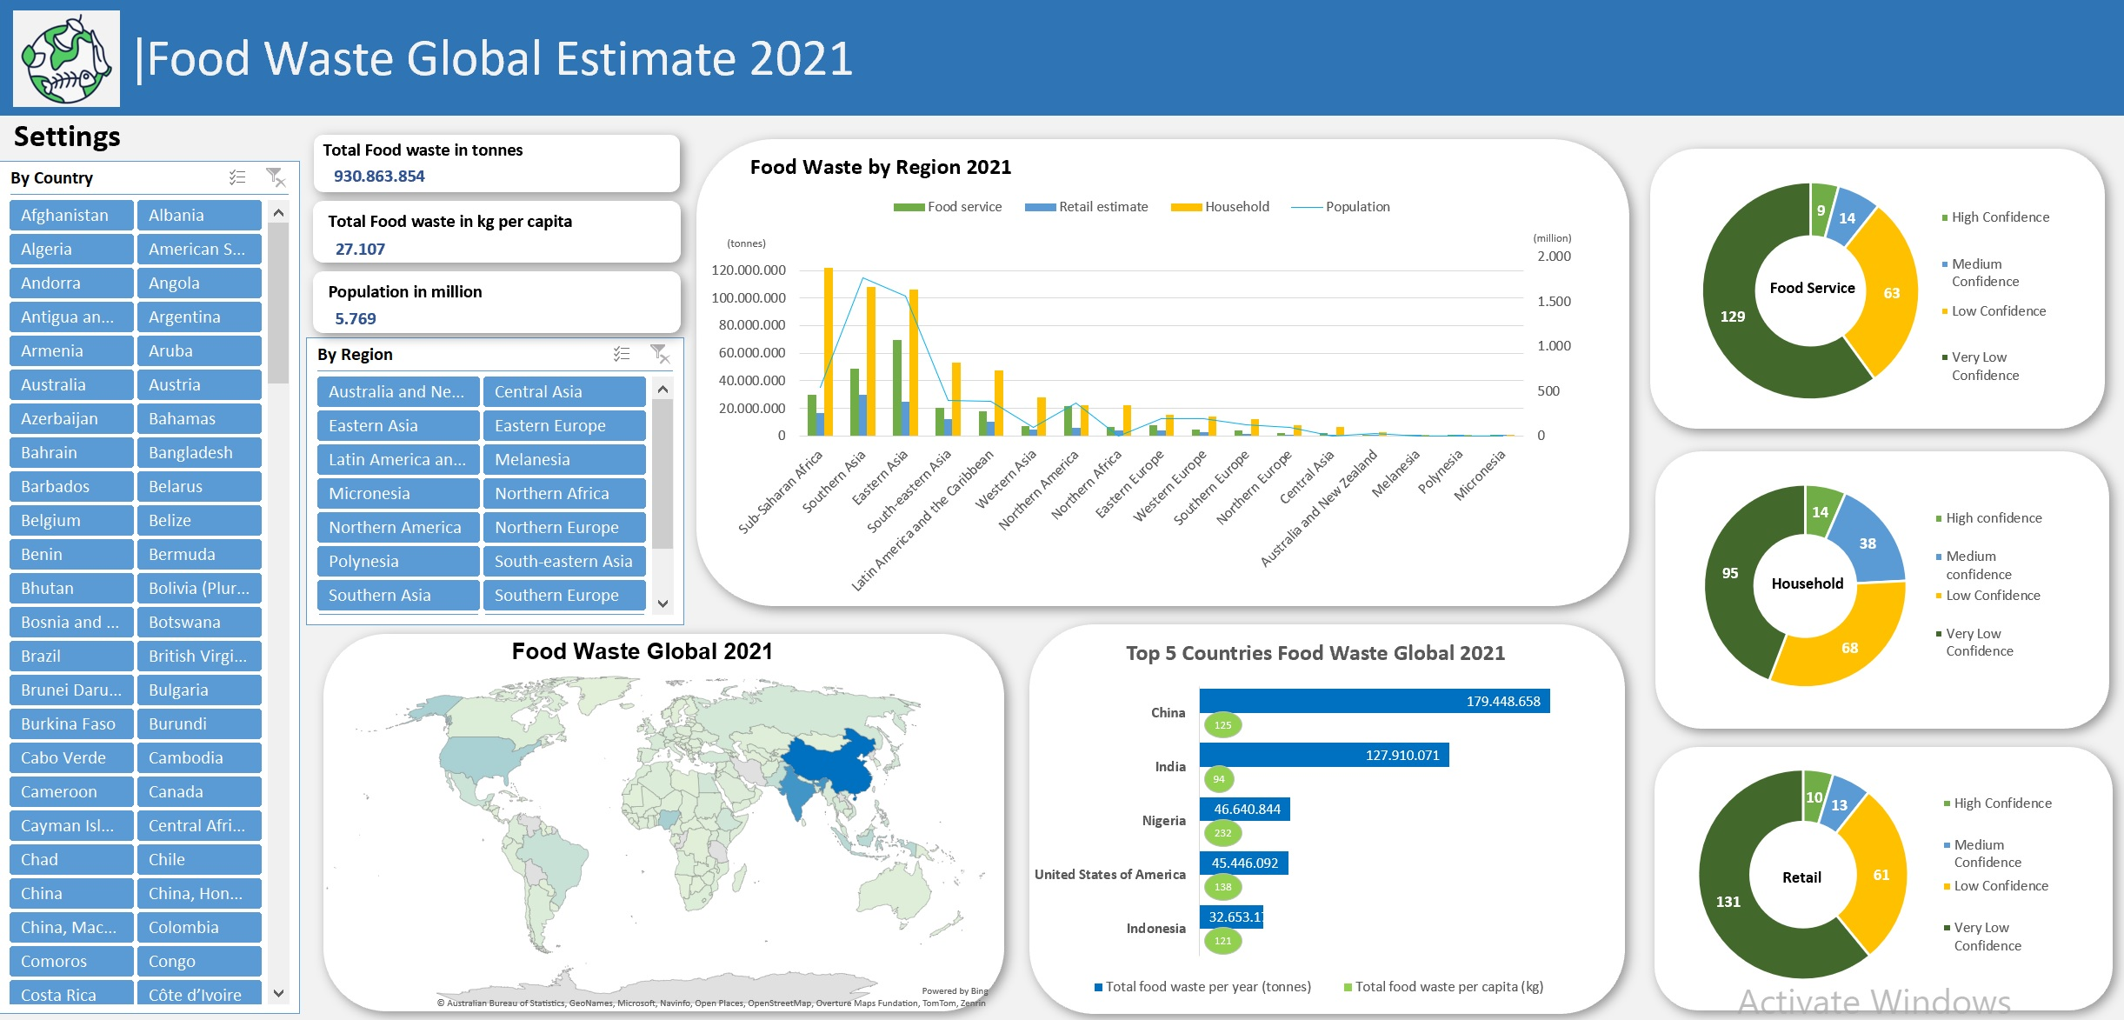
Dashboard analysis

Slide 9
Dashboard analysis
Slicer
Slicer

Slide 10
Dashboard analysis
Doughnut Charts
Clustered column interactive
Doughnut Charts
Choropleth Map interactive
Doughnut Charts
Clustered Bar interactive

Slide 11
Insights and Recommendations for Stakeholders
Stakeholders Insights Recommendations
Are major food waste contributors
Promote awareness campaigns, portion control tools
Consumers
Government and Regulatory Bodies
Waste Management and Recycling Companies
Startup Companies
Investors
Nonprofits and NGOs
Farmers
Environmental Organizations
Data reveals discrepancies geographical
Implement regulations
Is often improperly disposed of.
Enhance collection efficiency
Tech can target sectors with significant waste
Develop waste-tracking solutions
Food waste reduction offers investment potential
Fund waste reduction technologies
Surplus food can address food insecurity
Established redistribution programs
Overproduction and spoilage lead to waste
Improve crop planning and partner with food banks
Food waste impact climate and resource use
Advocate for sustainable practices

Slide 12
Insights and Recommendations for Stakeholders
Stakeholders Insights Recommendations
Public-Private Partnerships
Universities and Research Institutions
Food Manufacturing
Retailers
Restaurants and Food Service
Supply Chain Companies
Food Packaging
Social Media
Collaborations reduce food waste effectively
Support and promote the alliance
Data gaps need further study
Conduct research on waste reduction
Processing inefficiencies cause waste
Optimize production process and reduce surplus
Unsold inventory contributes to waste
Improve inventory management and donate unsold goods
Overproduction and portion control issue
Adopt portion control, repurpose food
Inefficiencies in transport lead to spoilage
Invest in cold chain technologies
Packaging extends shelf life
Develop sustainable packaging to reduce spoilage
Public awareness is crucial for behaviour change
Share data and success stories to engage audiences

Slide 13
Food waste Estimation A Global perspective
2021
Thank you !
Felipe Arenas

